Slide 1



Retirement Planning…
DO I HAVE ENOUGH?

Slide 2



Agenda –
The two key questions you need to answer…
Do I have enough?
What can I do once I have enough?

Slide 3

Do I have Enough??
 Oftentimes incredibly difficult question to answer without the help of a professional with financial planning tools.
 What are you trying to accomplish?
 You may or you may not…
 Your goals must be prioritized and realistic…
 ”What-if” scenarios should used
 Threats must be identified and mitigated for confidence
 Without a clear answer to this question, procrastination
oftentimes takes place…

Slide 4

YOUR Retirement Goals FIRST…
 Retirement lifestyle expenses (Must build in REALISTIC assumptions)
 Basic needs: Food, clothing, utilities
 Housing: Downsize? Upsize? Vacation Home?
 Travel: How many trips? How expensive?
 Entertainment: More time for Fun… Country Club? Something
else?
 Build a sinking fund?
 Healthcare costs/long-term care threats
 Are these threats mitigated with insurance?
 Are contingencies being made realistic?

Slide 5
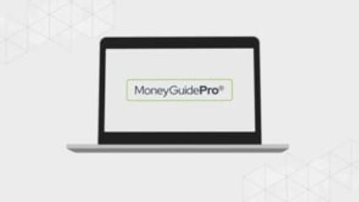
Can I Afford It?
The process starts with a deep dive into your personalized financial plan using sophisticated financial software for analysis and projecting potential outcomes…

Slide 6

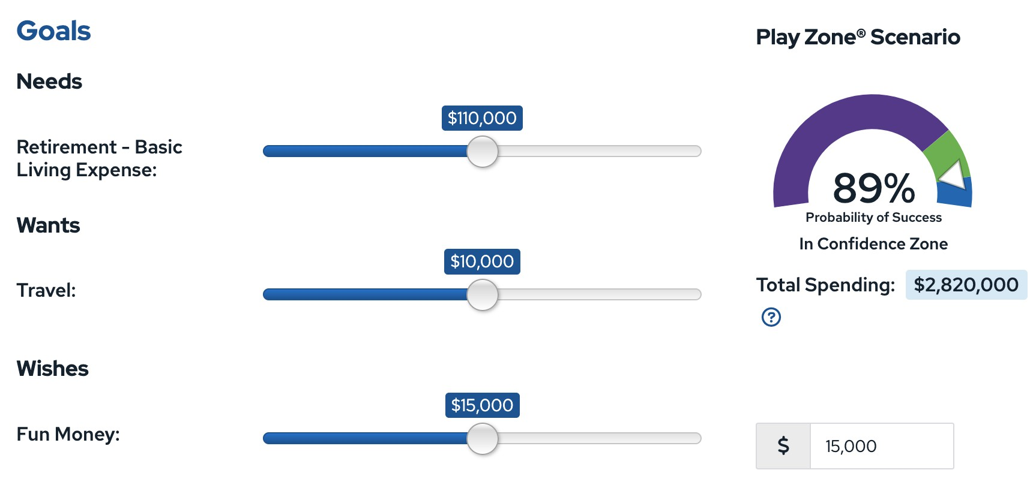
You’ll be asked questions about what you want to do in Retirement?
What if I want to enjoy it now?

Slide 7


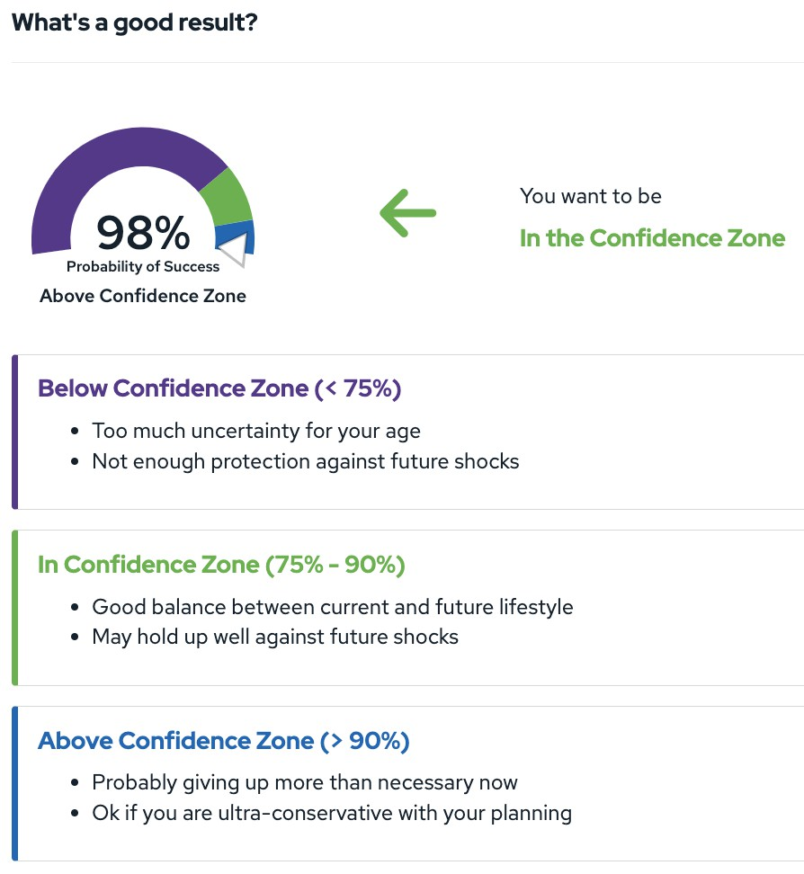
It will then provide you with a probability of success projection.

Slide 8





















Professional Advisors can help you solve questions and develop a plan for…
Yourselves
Your Heirs
Excess Assets
Vision
Timing
Assets to Gift
Tax Implications
Gift Tools
Your Team
Implementation

Slide 9
What is the next Step?
 We can connect you with a certified Retirement Specialist that provide you with a no obligation, pro-bono consultation focusing on:
The hierarchy of needs:
 Establish and implement a financial plan to meet your needs/wants/wishes
 Flesh out your charitable goals and determine your ability to achieve them
 Use our tools, expertise, and professional connections to execute these goals
 Monitor your on-going pan to make sure you are comfortable as circumstances change
 Connect you with other estate planning professionals such as attoreny, CPA, and tax specialists.
 If you would like to be connected with a local certified Retirement Planning Specialist, contact David Anderson at danderson@bgcmercerfoundation.org and he will make the connection for you.

